Slide 1
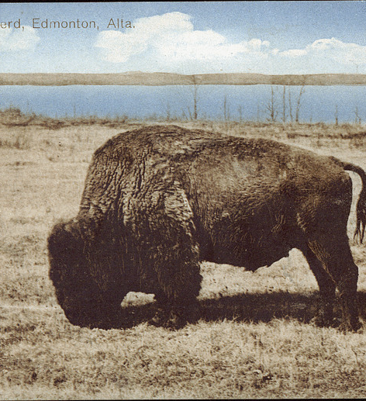
Elk Island and Canada’s Lost National Parks
Lauren Markewicz
How to Make a National Park: Let’s Find Out Podcast Live Show

Slide 2
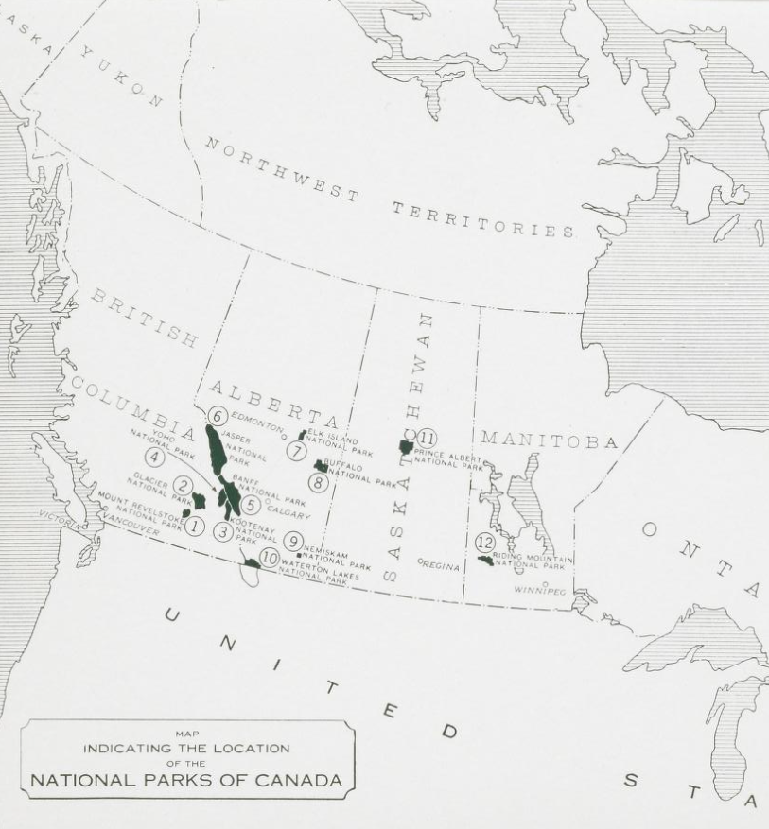
Cropped map of national parks of Canada, circa 1939, within promotional material for Riding Mountain National Park.
Image made available through Peel's Prairie Provinces, a digital initiative of the University of Alberta Libraries.
Notes:
https://archive.org/details/P011271/page/30/mode/2up?q=nemiskam&view=theater

Slide 3
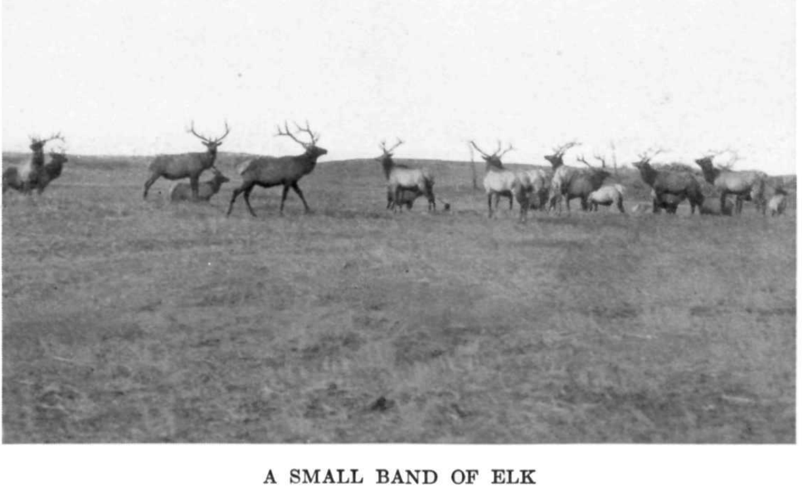
Image from 1934 Elk Island promotional booklet archived on parkscanadahistory.com
Notes:
http://www.parkscanadahistory.com/brochures/elkisland/booklet-1934.pdf

Slide 4
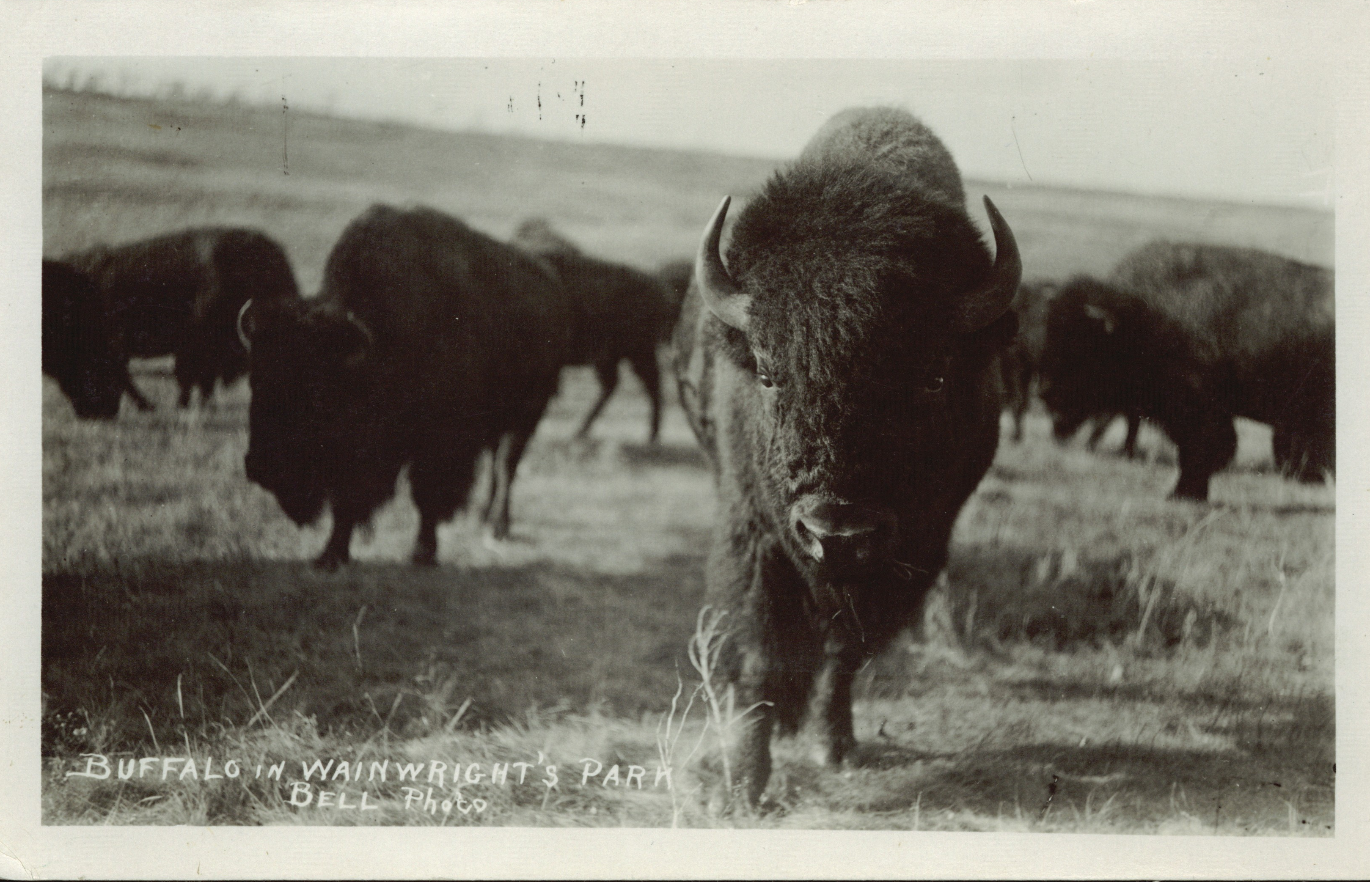
Image made available through Peel's Prairie Provinces
Notes:
https://archive.org/details/PC005127

Slide 5
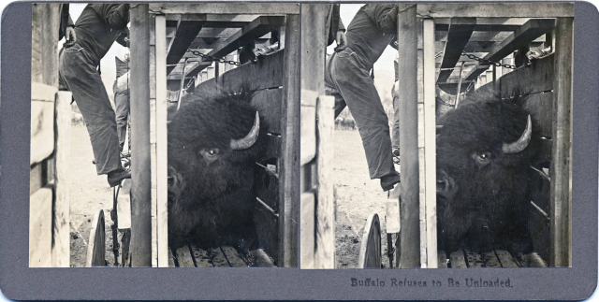
Stereograph by N.A.. Forsyth. Image from the Montana Historical Society.
Notes:
“Buffalo Refuses to Be Unloaded,” by N.A. Forsyth. Image from the Montana Historical Society.

Slide 6
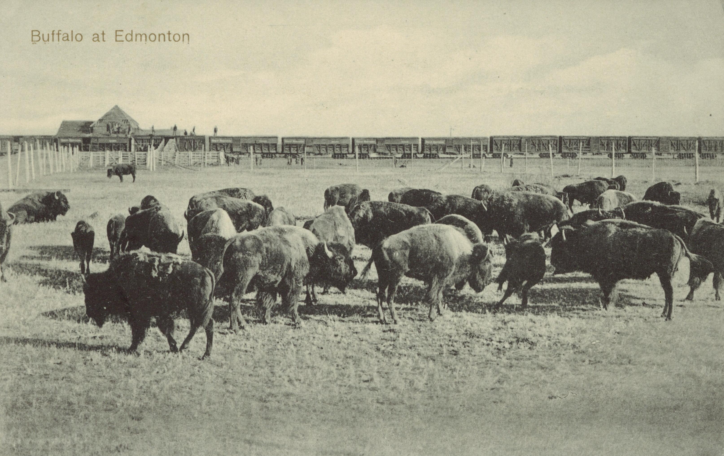
Image made available through Peel's Prairie Provinces
Notes:
https://archive.org/details/PC006885

Slide 7
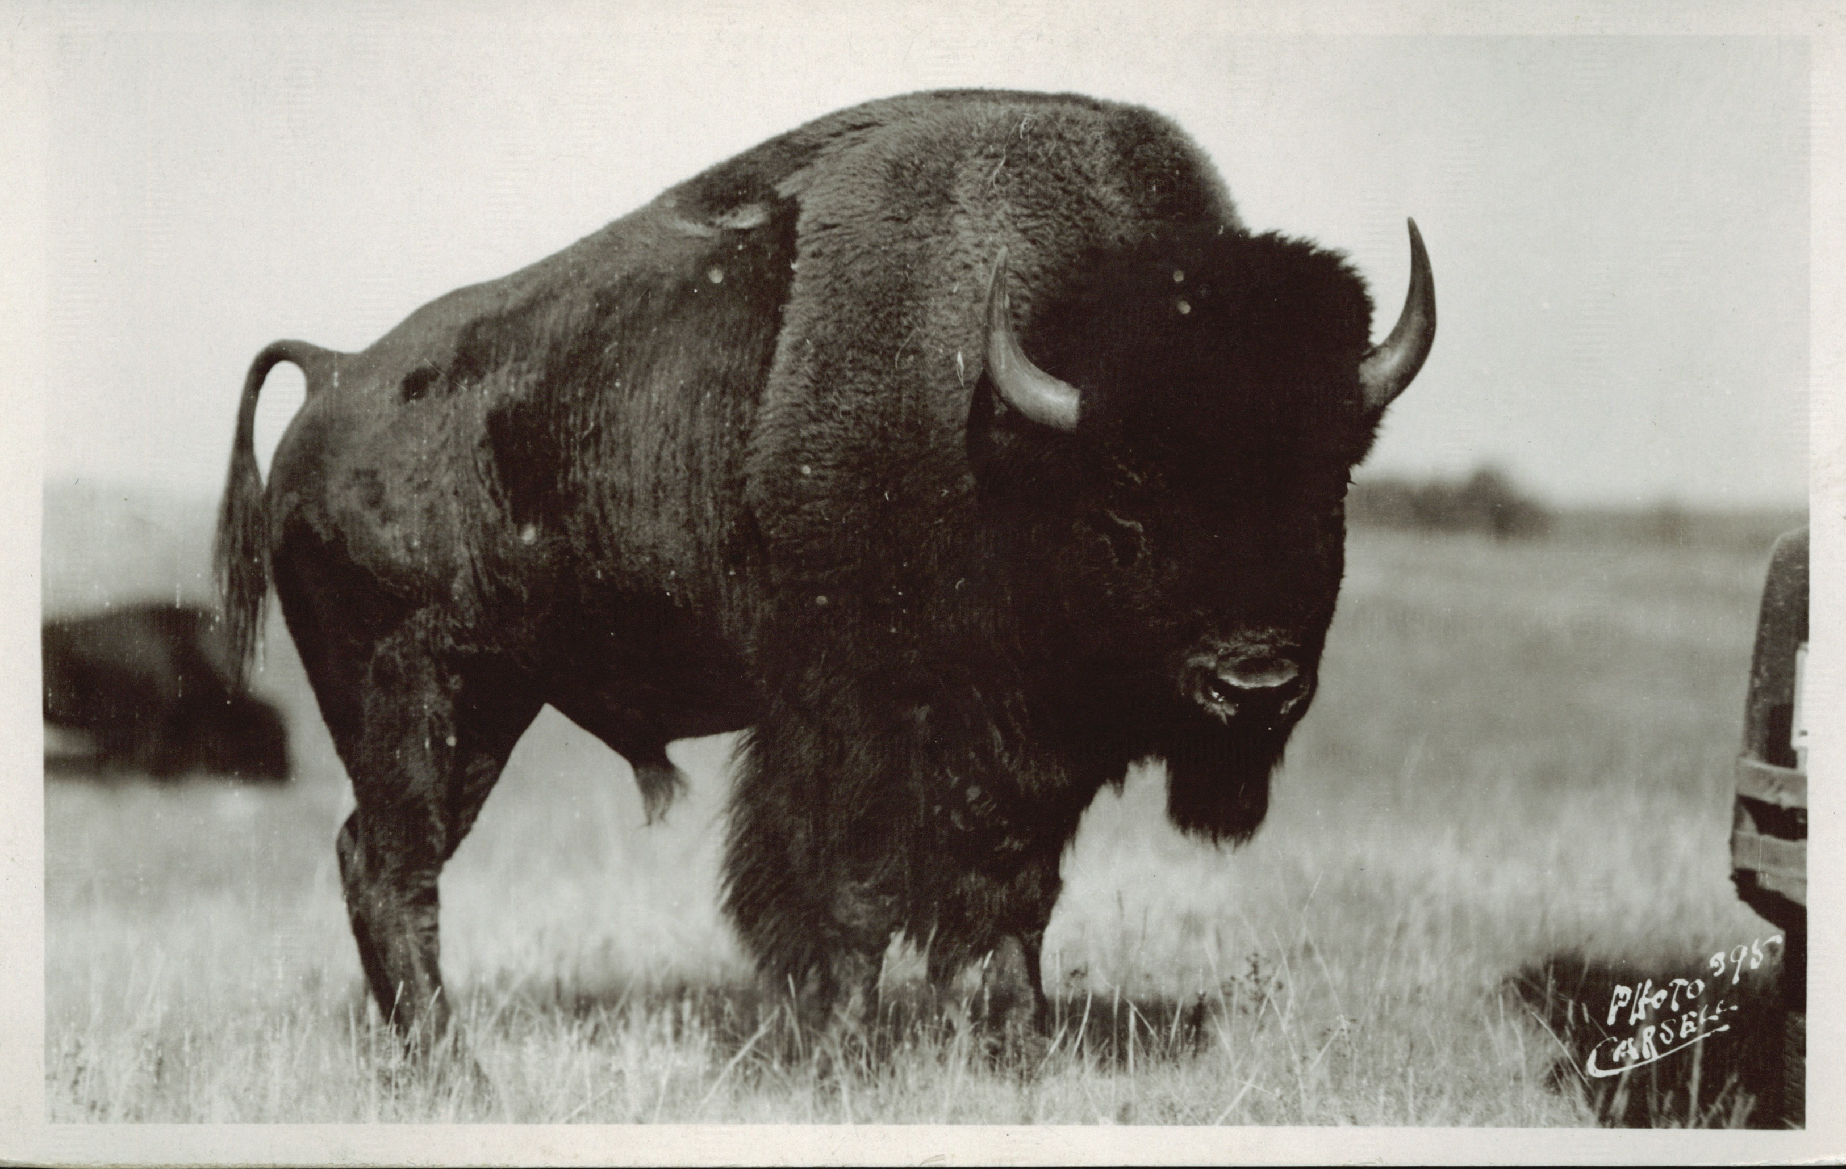
Image made available through Peel's Prairie Provinces
Notes:
https://archive.org/details/PC005119

Slide 8
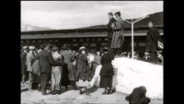
Library and Archives Canada YouTube channel

Slide 9
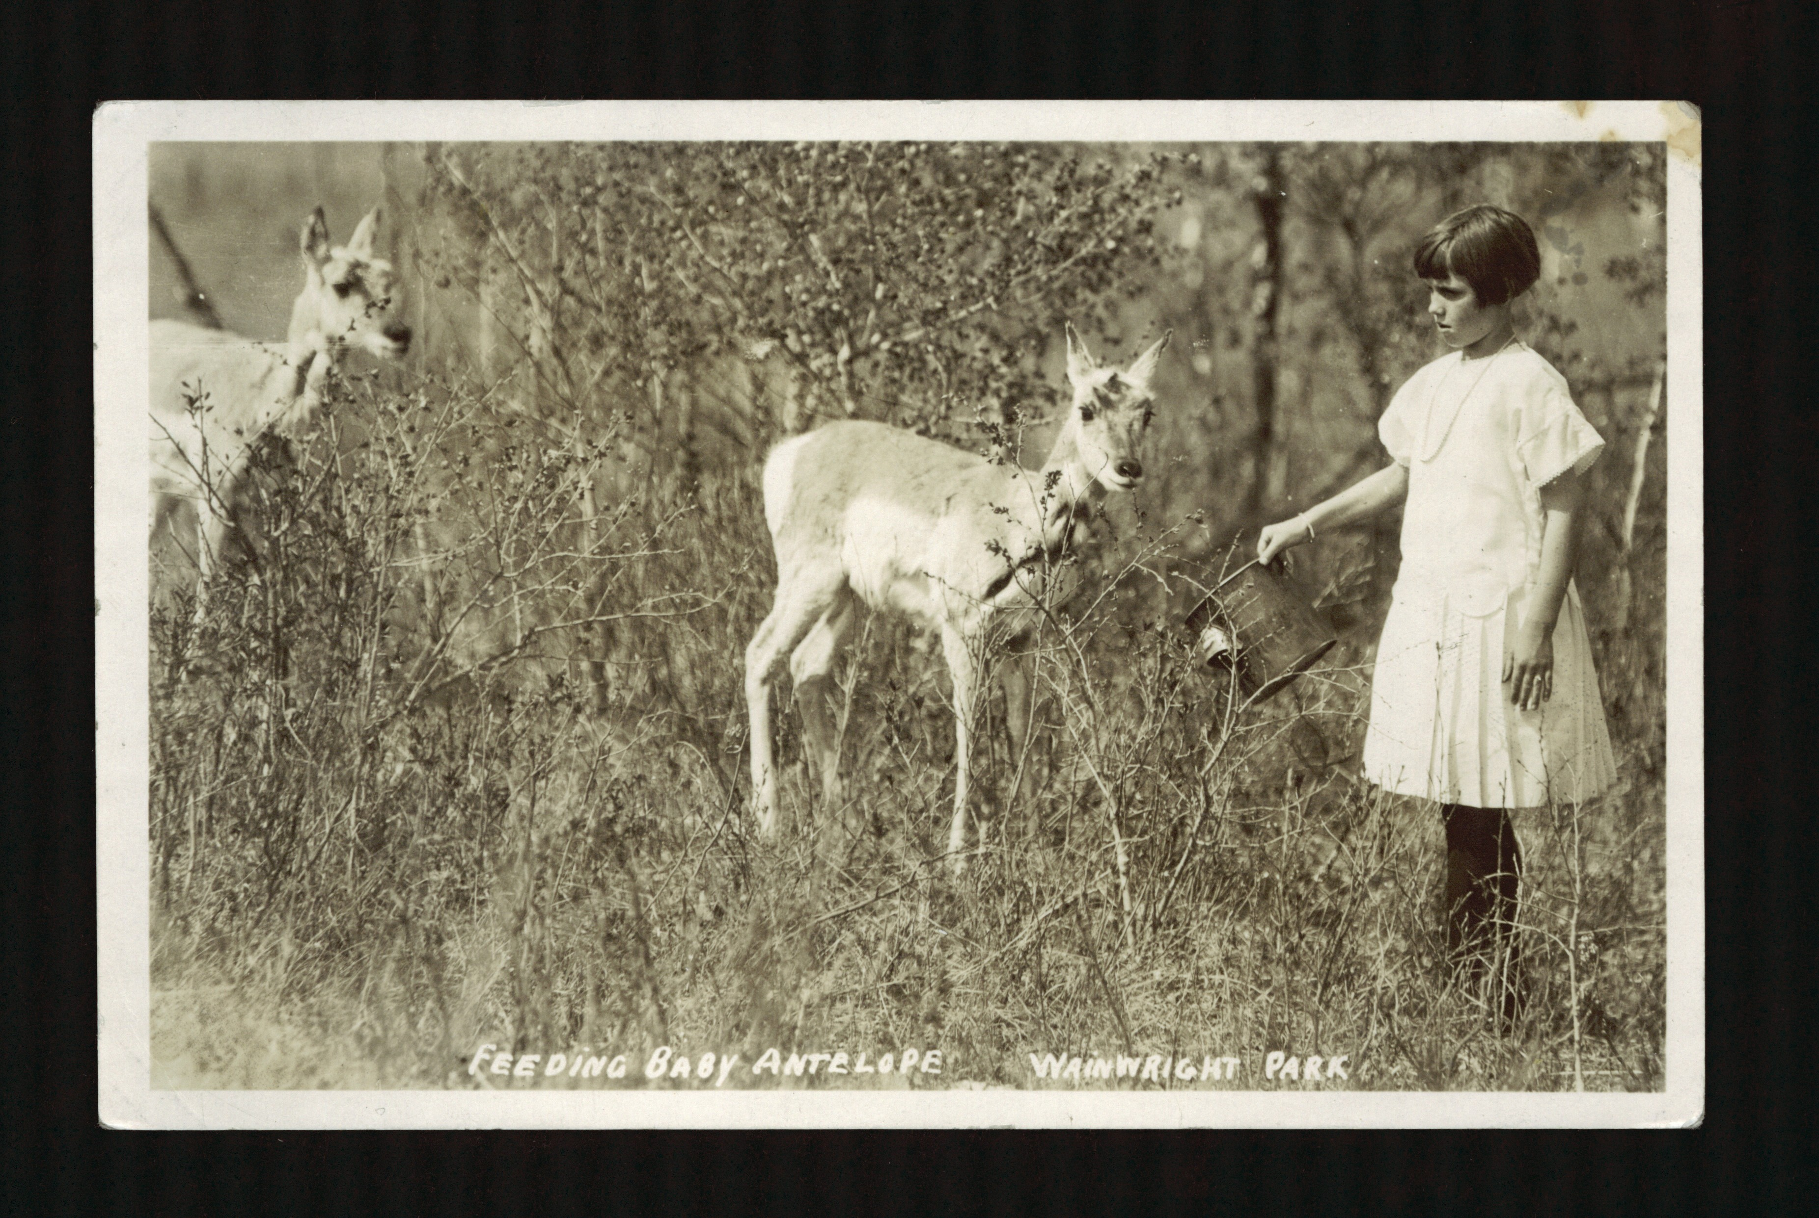
Image made available through Peel's Prairie Provinces
Notes:
https://archive.org/details/PC005102

Slide 10

Image made available through Peel's Prairie Provinces
Notes:
Map including abattoir: http://www.parkscanadahistory.com/brochures/elkisland/brochure-1938.pdf

Slide 11
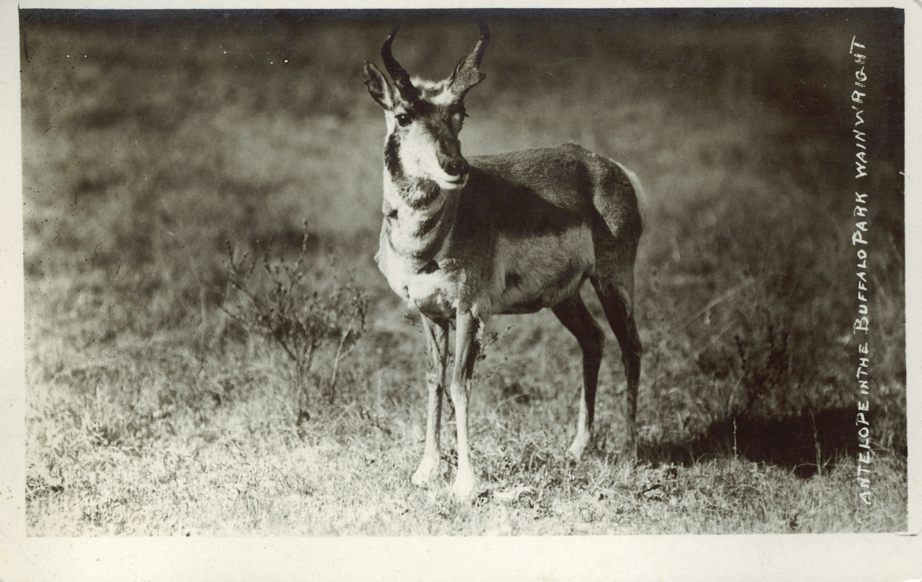
Thank you
Lauren Markewicz
lamarkewicz@gmail.com
Historyboots.wordpress.com
Image made available through Peel's Prairie Provinces

