Slide 1
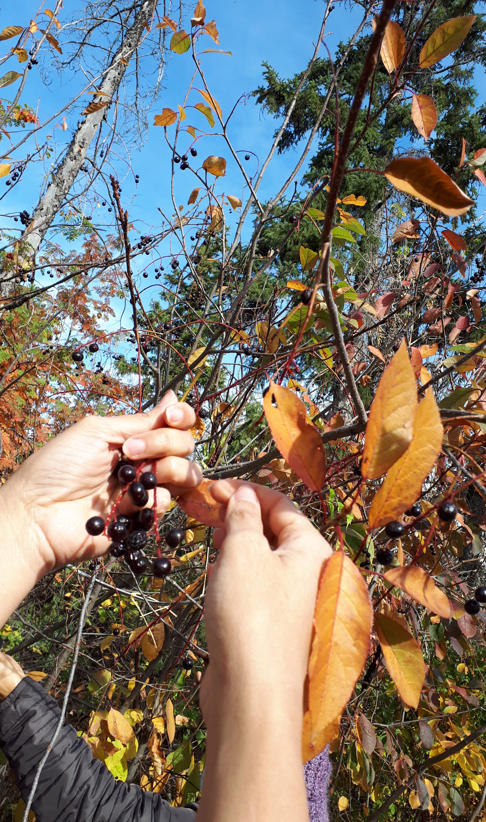
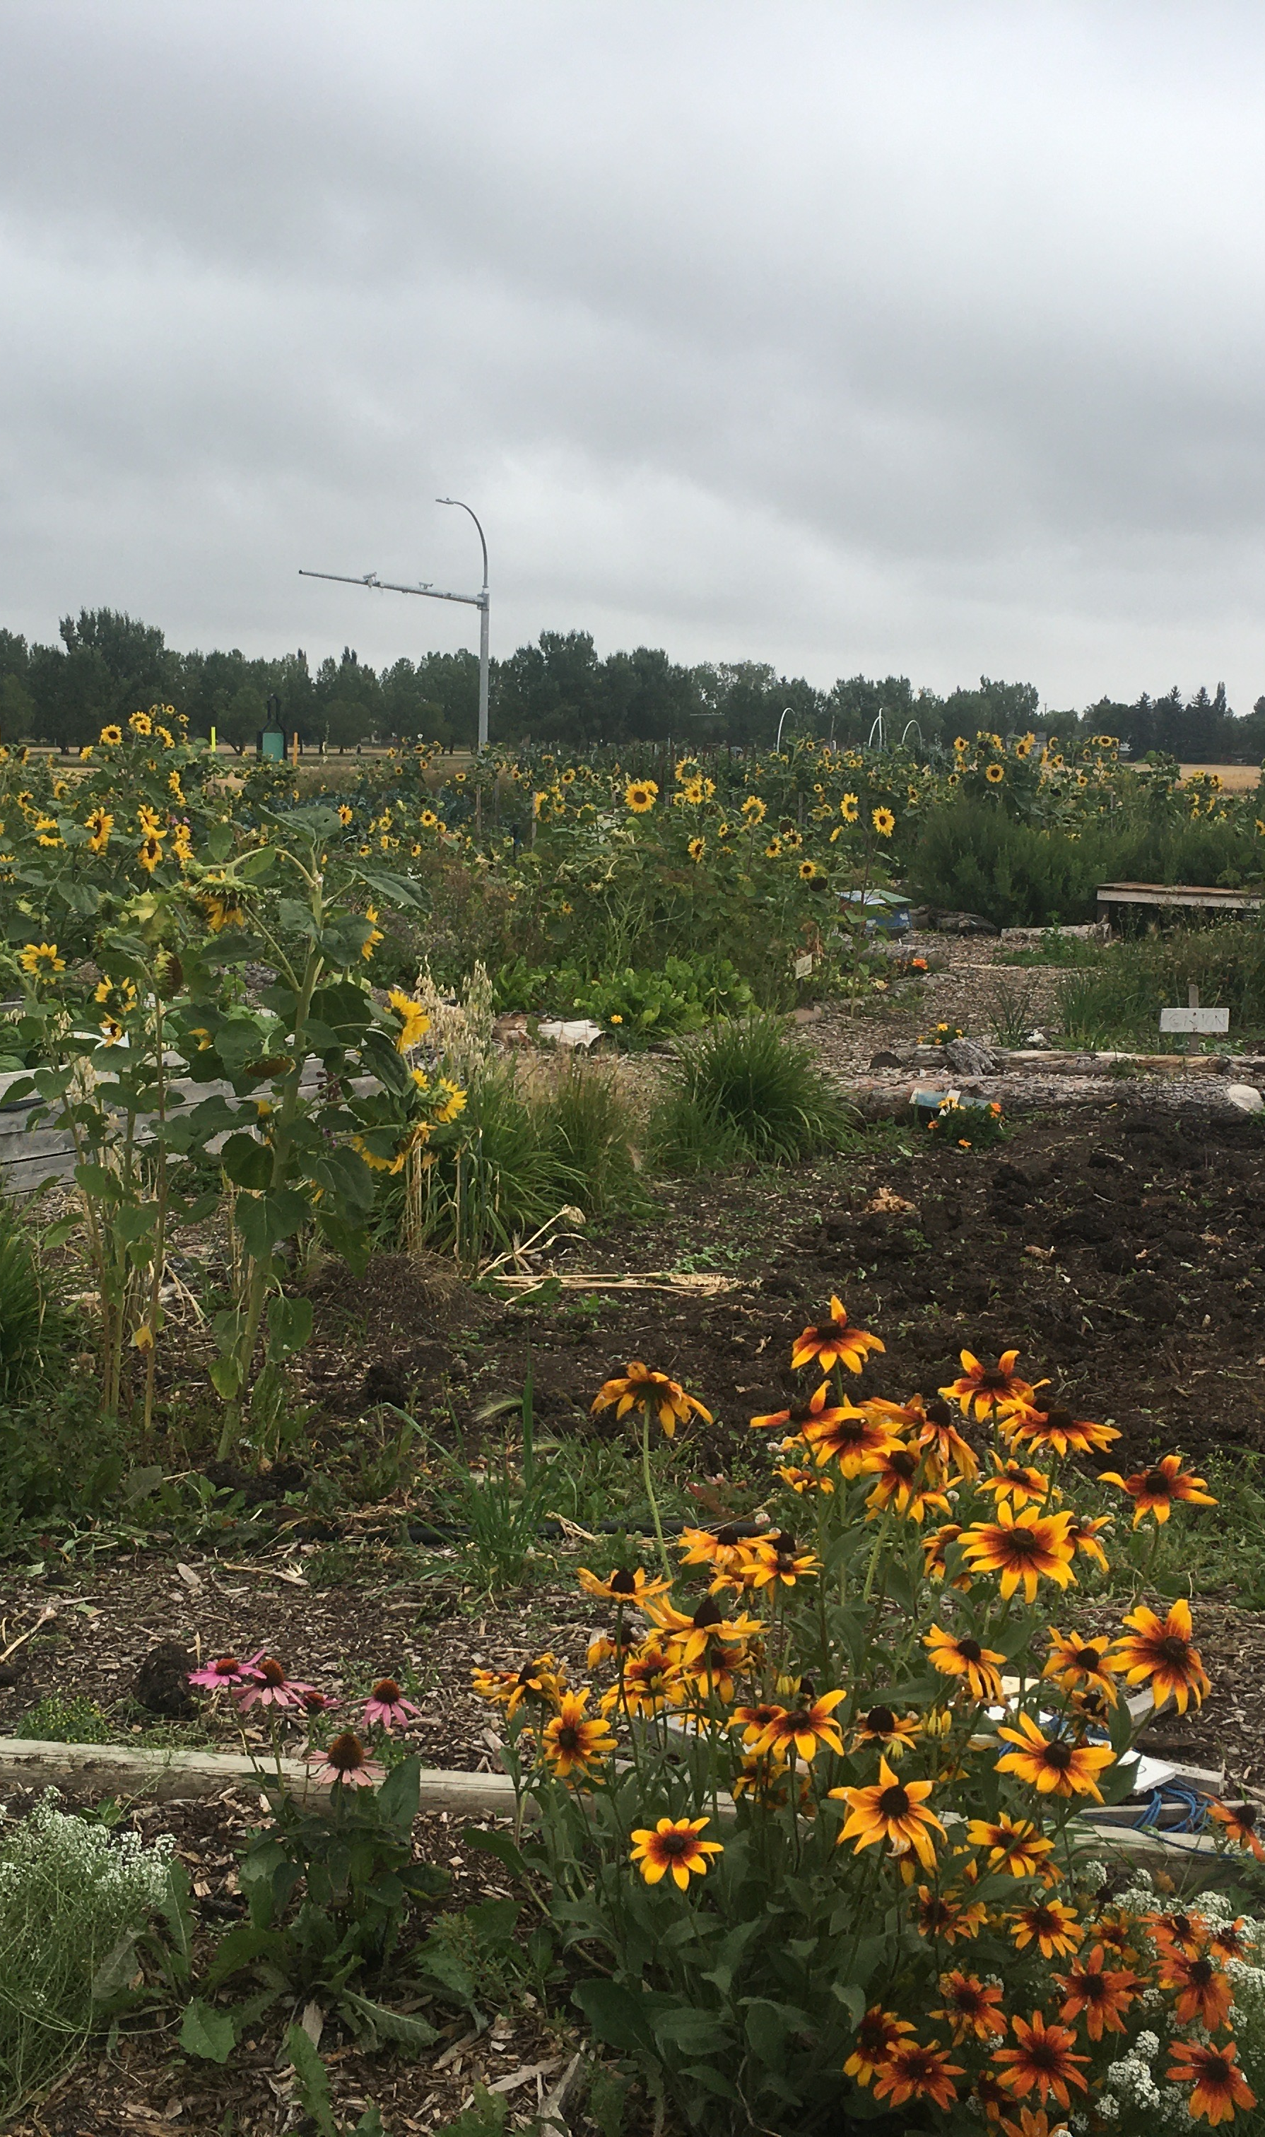
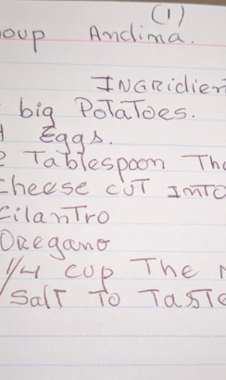
Rat Routes and Reasons to Gather
Treaty 6
ᐊᒥᐢᑲᐧᒋᕀ ᐋᐧᐢᑲᐦᐃᑲᐣ Edmonton
Sarah De Lano
Notes:
…Thanks for inviting me, berries are probably my favourite thing to tlk about, other than my kid and my dog
“The University of Alberta respectfully acknowledges that we are located on Treaty 6 territory, a traditional gathering place for diverse Indigenous peoples whose histories, languages, and cultures continue to influence our vibrant community.” (adapted from: University of Alberta, 2021)
Very interested in this connection between gathering and community. Continues to be, where we gather, we also gather plants, berries, foods…where we gather those things we also gather. Berry picking as community building and as a way to connect to the land and its many stories and histories…and our shared future.
Picking berries brought me closer to my own history, but also to my new community here in Edmonton, and I have been lucky enough to combine the two in my research and work.

Slide 2
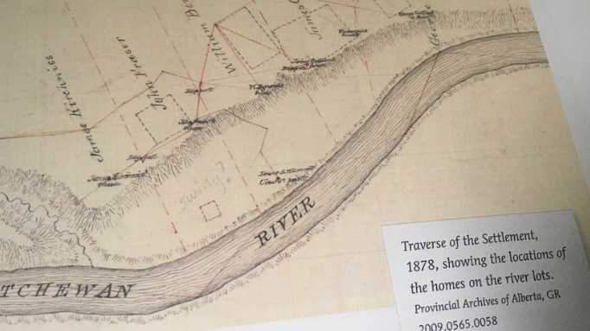
Notes:
I am metis, and approx. 70 % of metis people like me, live in urban centres. Its also important to remember that historically many metis people lived right here in the city as well, and in fact metis river lots shaped the original urban form in Edmonton, including the neighbourhood of mccauley. The ward that I live in, Im from Parkdale, is part of ward metis, based on the many river lots in the area. River lots included farm land, but also areas close to the river for trapping and foraging berries and other plants
Some original river lots, mostly metis families with a lot of kinship ties. Kirkness, 26 is where the ravine now sits, frasers are ancestors of mine, and a local historian told me that the fraser and kirkness children were good friends and likely picked berries together in the ravine space, so it is a very special area for me for many reasons, I now pick plants and berries here with my daughter and also with my students and friends. I worked with the MNA the past summer and wrote a report on urban harvesting by metis people, and found that most bylaws here technically prohibit foraging in the ravine and other river vally space, and so I think its really important to highlight how different cultures relate to the river valley space historically and presently. Not just my own cultural ties, but others…I love the goji work that Fei does, for example…tracing vibrant community land connections historically and presently

Slide 3
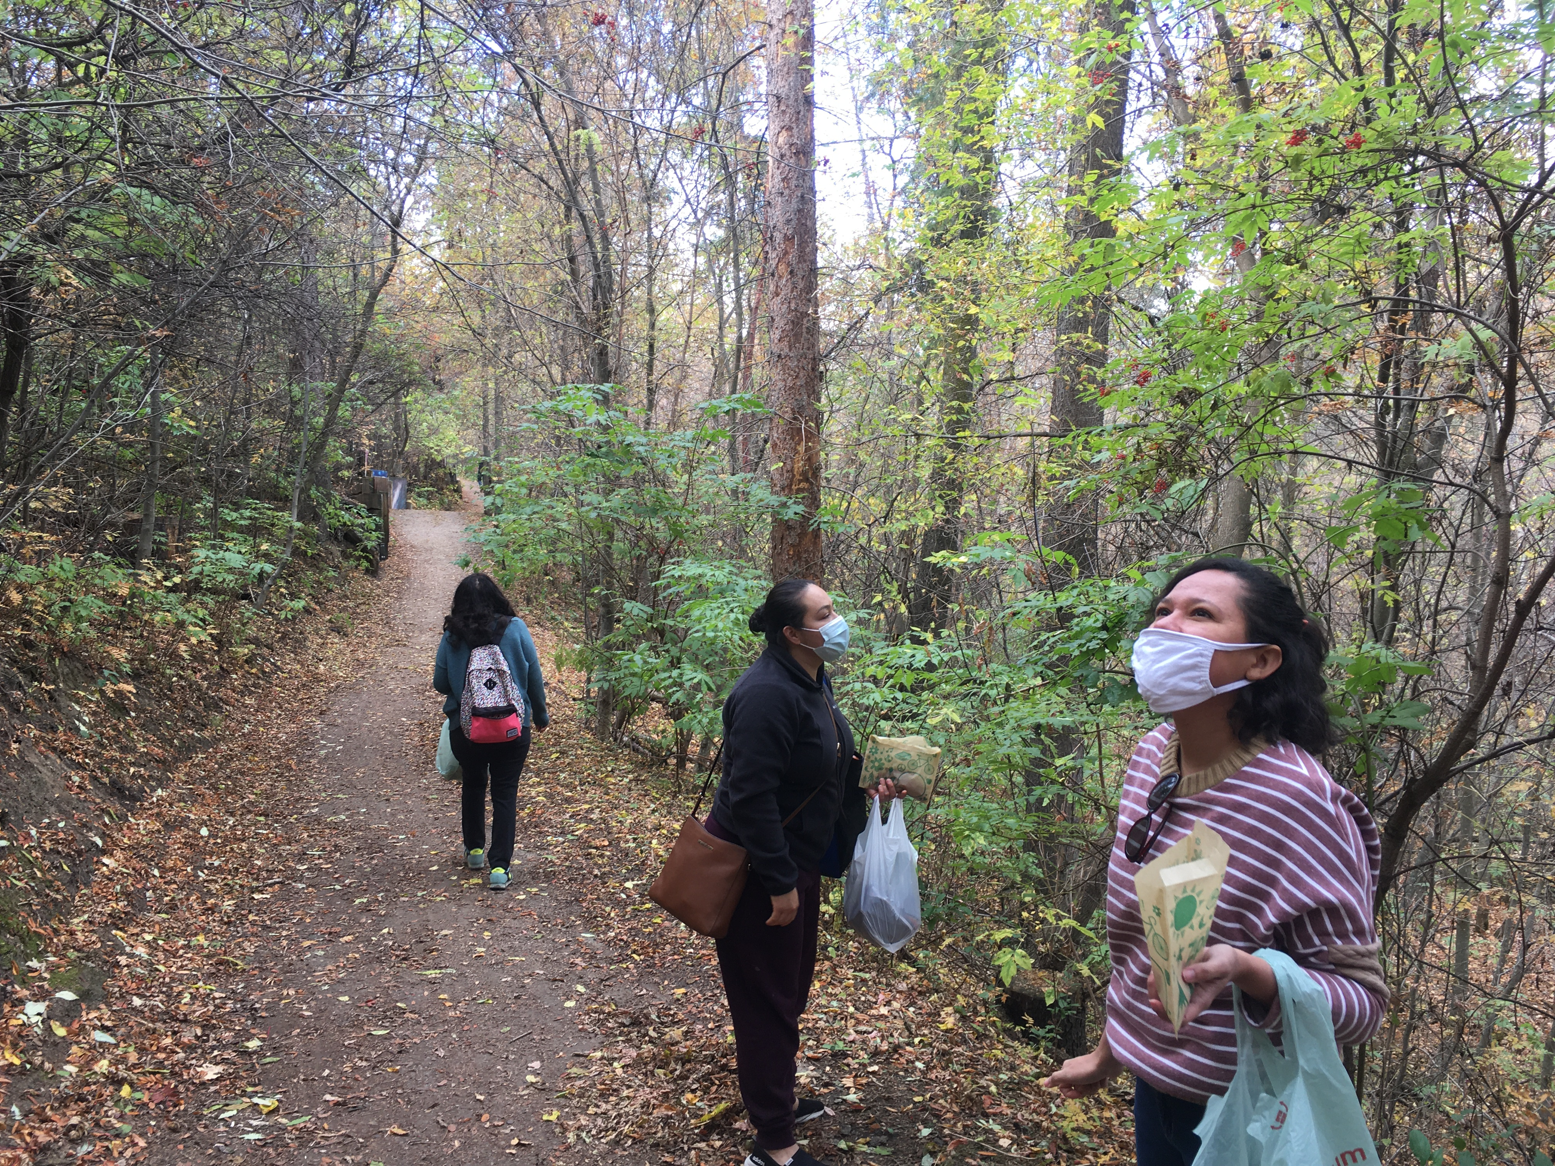
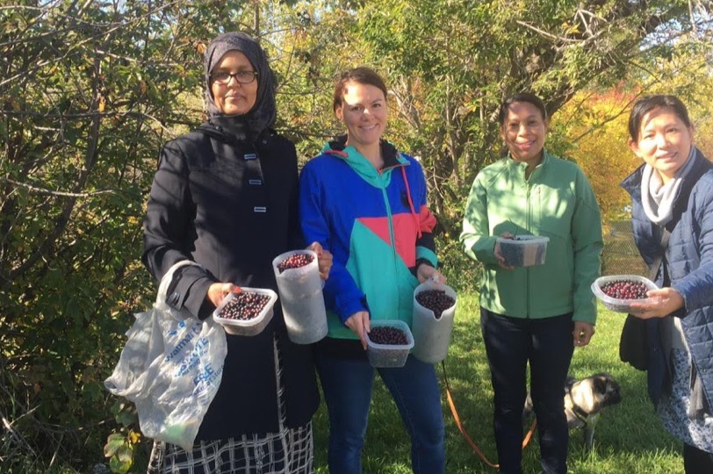
Notes:
Harvesting as a community creates relationships (part of metis culture, every culture…sometimes lost in urban centres) social capital and belonging, brings to light different perspectives, stories, knowledge about food and the land. I have worked at MFRS for over 10 years…I know because I took prenatal classes there and my daughter is now 11. We learn about language and community and we also pick berries and plants together,

Slide 4
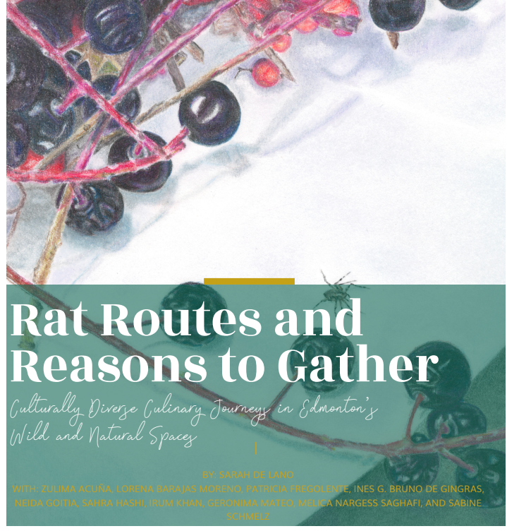
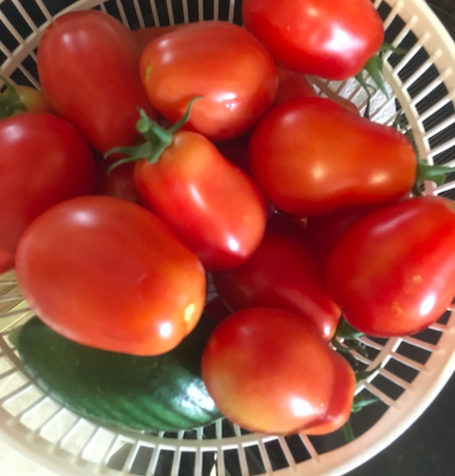
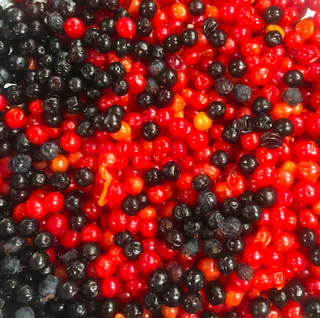
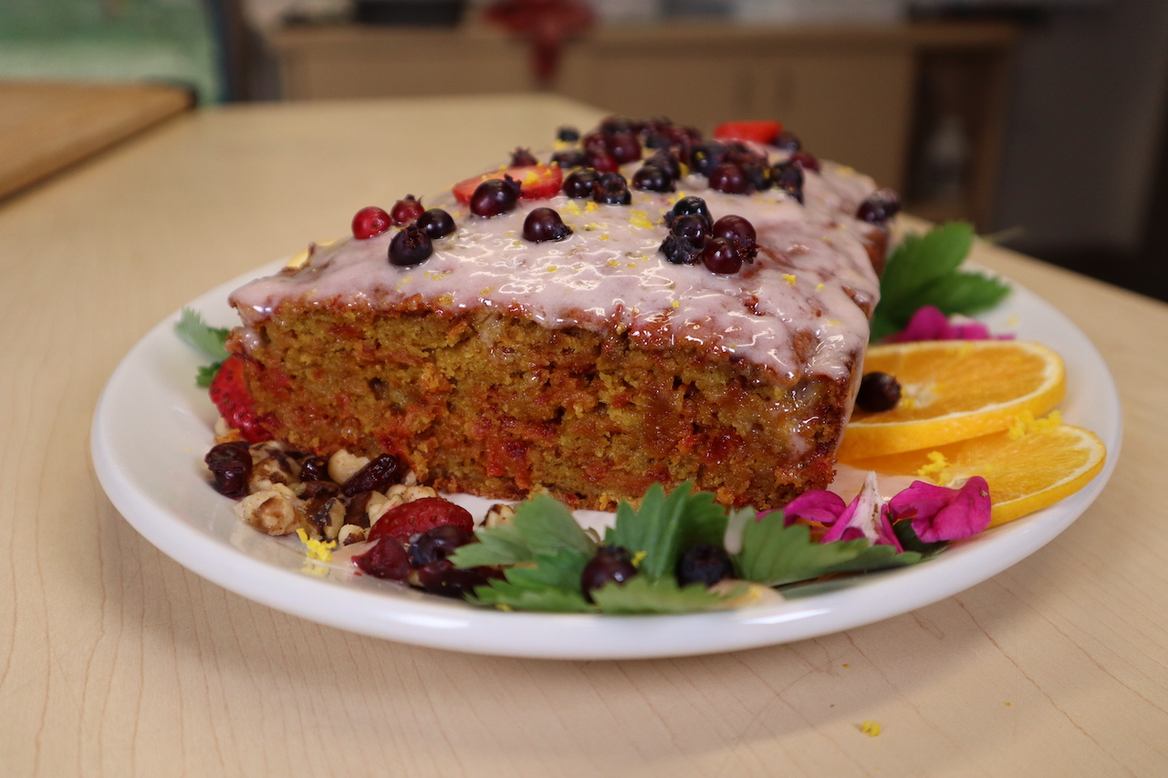
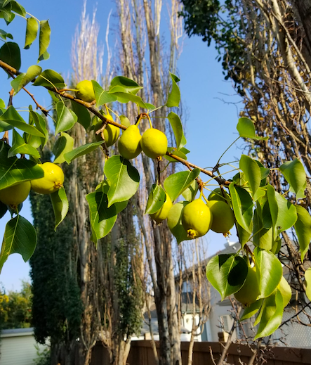
Notes:
Berries as research: better done in community, lots of reflecting and gathering, telling and listening to stories, sorting the berries/plants, different uses for each, many possible outcomes, shared with all.

Slide 5
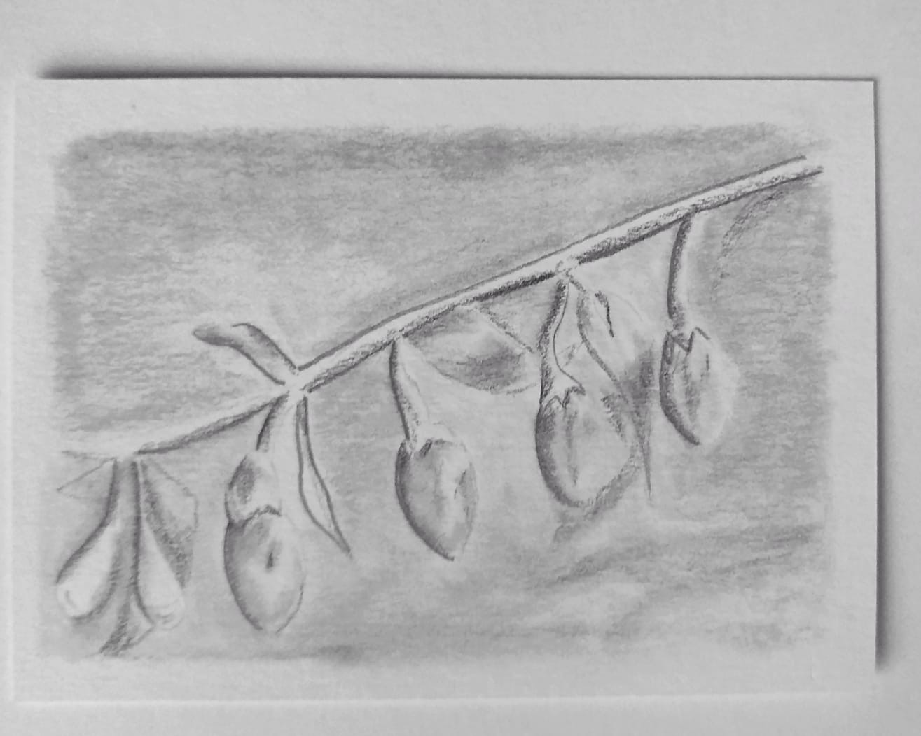
Rat Routes
1. How can participation in urban agriculture/foraging and the creation of place-based recipes support feelings of belonging for a group of immigrant women, and myself, a Métis woman in Edmonton?
2. How can such citizen participation facilitate the re-imagining of communities, urban agriculture and greenspaces in Edmonton towards a more inclusive and sustainable future?

Slide 6
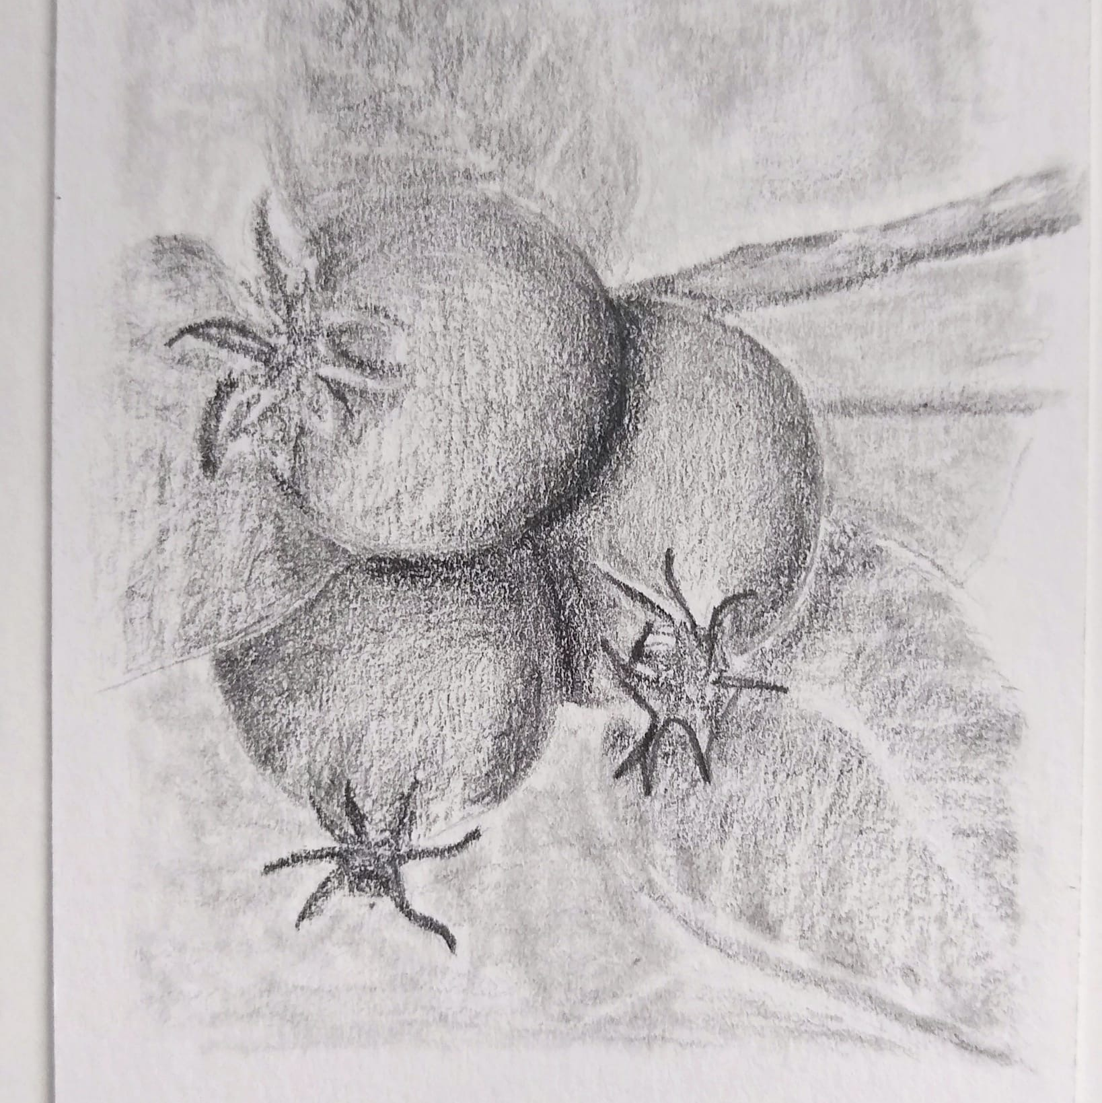
Reasons to Gather
Social inclusion: Not just getting people into urban gardens and forests, freedom to define the space and co-create knowledge.
Building an equitable future: Questioning dominance of a certain perspective on nature and park space, confronting histories of exclusion in food systems and greenspace.

Slide 7
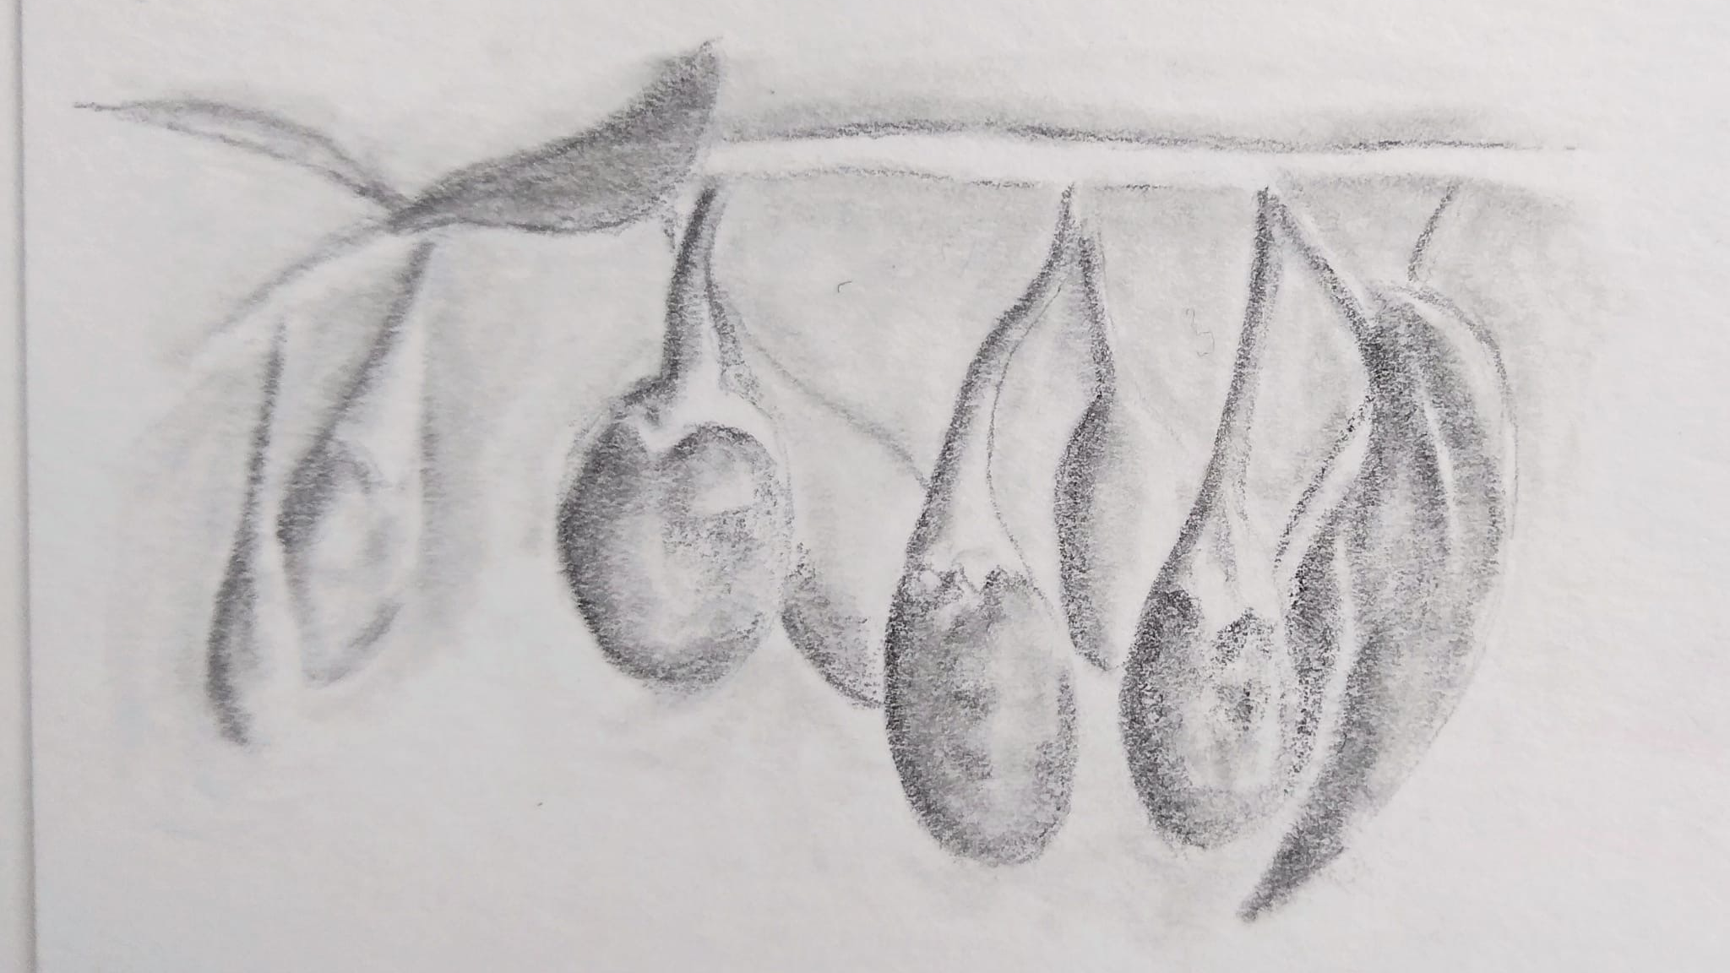
Original art by Zulima Acuña, 2021.

Slide 8
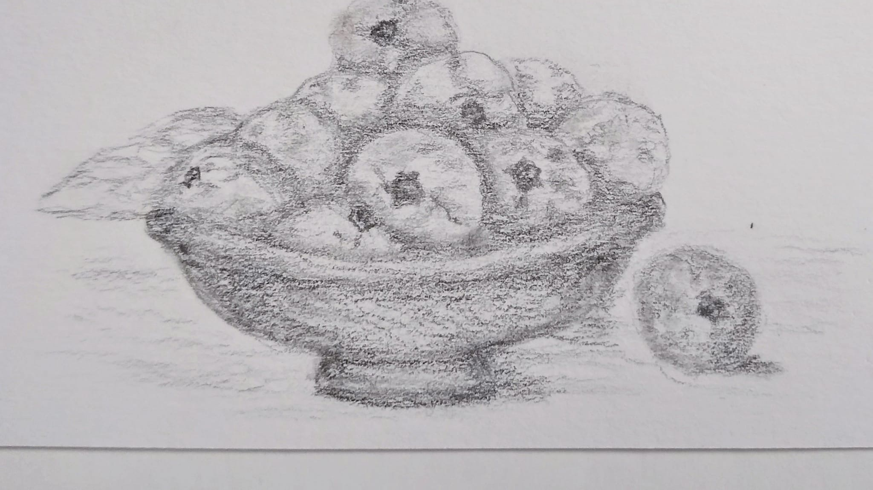
Thank you for listening!
¡Danke, Dhanyawad, Gracias, Grácies, Mahadsanid, Mamnoun hastam, Marsee, Obrigada, Shukriya, Thanks!
sdelano@ualberta.ca
Recipe Book at Audrey’s Books
Free online version: https://era.library.ualberta.ca/items/c709557d-9674-4b20-aa63-e03178eaf0df

Slide 9
